Slide 1
Android Unpackers
Przemysław Warias

Slide 2

Android Unpackers
Android packing in general is the encryption, obfuscation of code in order to prevent analysis.
Packing has both legitimate and illegitimate uses.
Often used to sneak malware onto the google play market.

Slide 3
Project Outline
Understand 4 current unpackers, and compare/contrast them
DexHunter
FUPK3
FART
Youpk
Challenges to note
Google Translate is inaccurate
I'm not an expert in Android
Notes:
All of the unpackers rely on modifying Android source code to insert instrumentation. This is because Emulation/debugging detection mechanisms have become very popular within packers

Slide 4
DexHunter
Summary
Modifies ART Runtime
Hooks the Loading methods (DefineClass)
This is the given API to load code, your not forced to use it
Write a custom loading functions and evade the hook

Slide 5
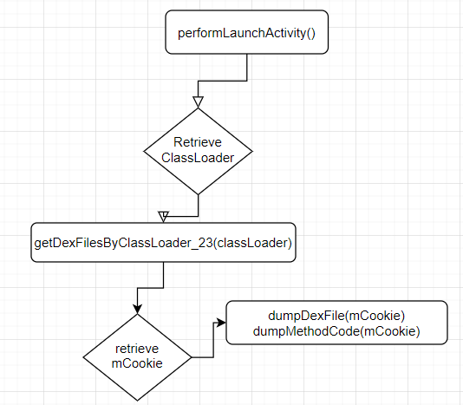
FART
FART works in 3 steps
Dump the DexFIle structure in memory
Similar to the method proposed by Avi Bashan and Slava Makkaveev
Call each method in the class and dump the CodeItem
Repair extracted method
Improves on DexHunter’s shortcomings
Works on Android 6.0, and can theoretically be transplanted
Frida version runs on Pixel with version 8.0
Works with Frida
Has been improved
Notes:
Dump the DexFile structure in mem:
Differs from Avi’s (they modify DexFile::DexFile()) method because app can implement custom Classloader to which decrypted dex is attached, so FART, finds said classloader, and obtains DexFile structure using reflection mechanism. In detail there is instrumentation added in the performLaunchActivity() method because by the time it is called the program should be decrypted, and therefore the classloader is now known.From there you call getDexFilesByClassLoader_23(classLoader) which returns an mCookie that is then used to find the location of the decrypted DexFile in memory. Lastly two native methods are added dumpDexFile(), and dumpMethodCode(), both of which utilize the aforementioned mCookie to find where the decrypted DexFile object is in memory and dump it.
Call each method in the class and dump the code:
This process is similar to the one used by Fupk3 (as referenced in this article here https://bbs.pediy.com/thread-252630.htm) where you traverse the decrypted class and call functions found within it so that they may be loaded and thereby decrypted. I believe this is a solution to the layered unpacking approach used by DroidUnpack.
Repair: After the dexFile structure, and functions are dumped from memory, the included fart.py cleans up both the files and gives you a .txt file which contains the decrypted smali code.

Slide 6
FUPK3
An unpacker similar to DexHunter
Unpacking is DVM based, but a closed source ART version exists
Principle is the same however it is much more complicated
Mechanism
Traverse the dvmUserDexFiles() structure to find cookies for loaded dex
Done in Native layer as opposed to Java layer
Trigger functions and intercept decrypted code_item in the parser class
Modern packers have made work-arounds for this tool
Notes:
One thing I need to figure out is how exactly packers bypass this. Is it simply that it’s DVM based or does it have a similar Achilles heel where apps can use a custom loader.

Slide 7
Youpk
ART based unpacker that performs active calls
Similar to the method employed by FART and FUPK3
Only testable on the Pixel 1
Dumps dex by retrieving DexFile reference from ClassLinker object
From there the DexFile is traversed a call chain is performed and data is decrypted

Slide 8
What’s next?
Better understand the tools
Better understand each tools limitations
Try to actually test these tools and compare their performance

Slide 9
References
Fart
https://bbs.pediy.com/thread-252630.htm
https://bbs.pediy.com/thread-254028.htm
https://bbs.pediy.com/thread-254555.htm
FUPK
https://github.com/F8LEFT/FUPK3
https://bbs.pediy.com/thread-246117.htm
Youpk
https://github.com/Youlor/Youpk

